Slide 1
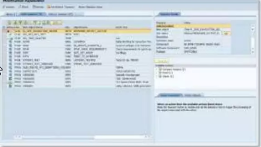
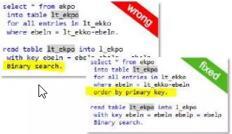
Adjust modifications:
Transactions SPDD and SPAU same process as in previous upgrades
Recommendation:
Reset as many objects as possible to SAP standard
Fix SAP HANA Findings
Use code inspector variant FUNCTIONAL_DB
Same checks as for the migration to SAP Business Suite on HANA
Fix SAP S/4 HANA Findings
Use custom code overview and code inspector checks related to SAP S/4 HANA.
Adapt findings as described in the referenced SAP Notes

